Slide 1
moodlight
ETP2 – FS2018
F.Baumann & J.Schönenberger
Notes:
jonas

Slide 2
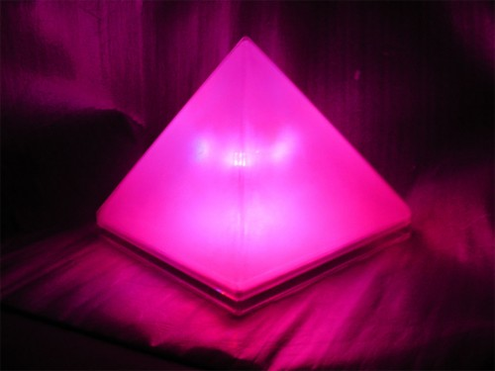
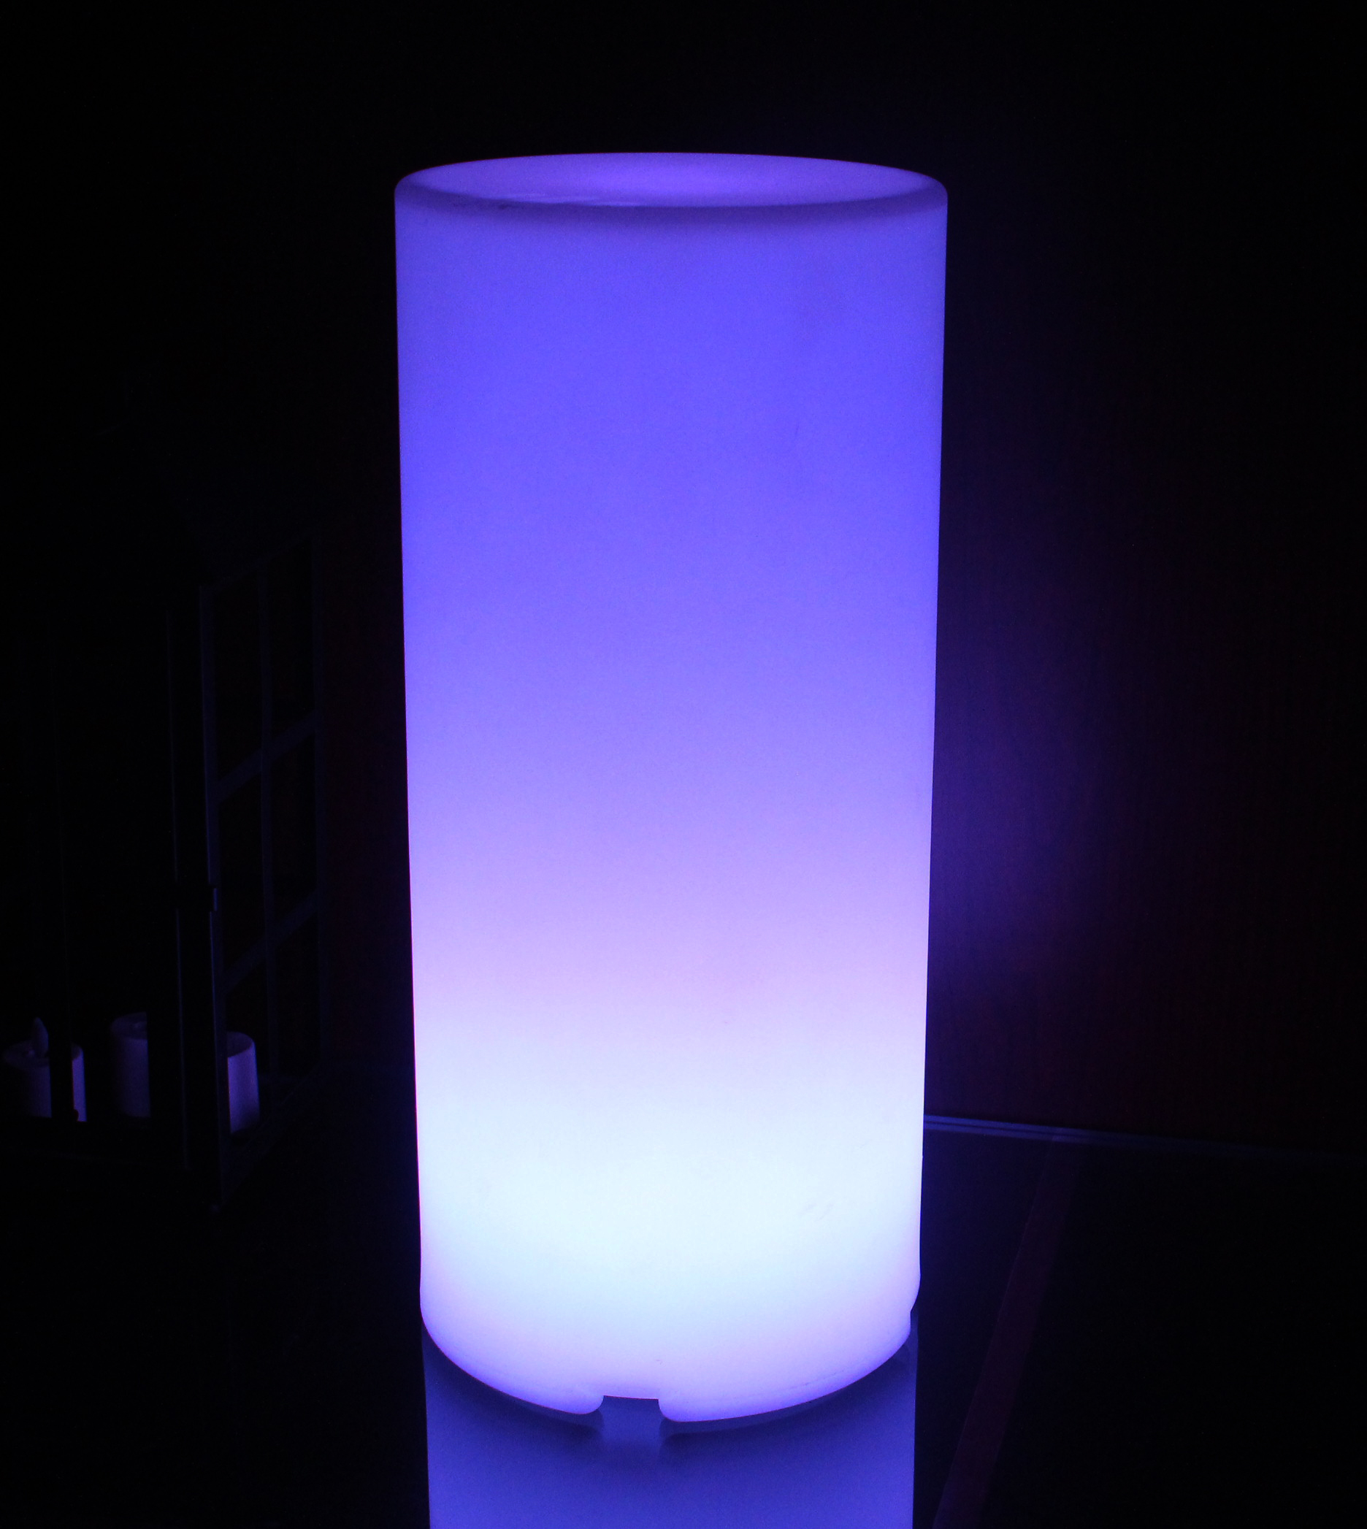
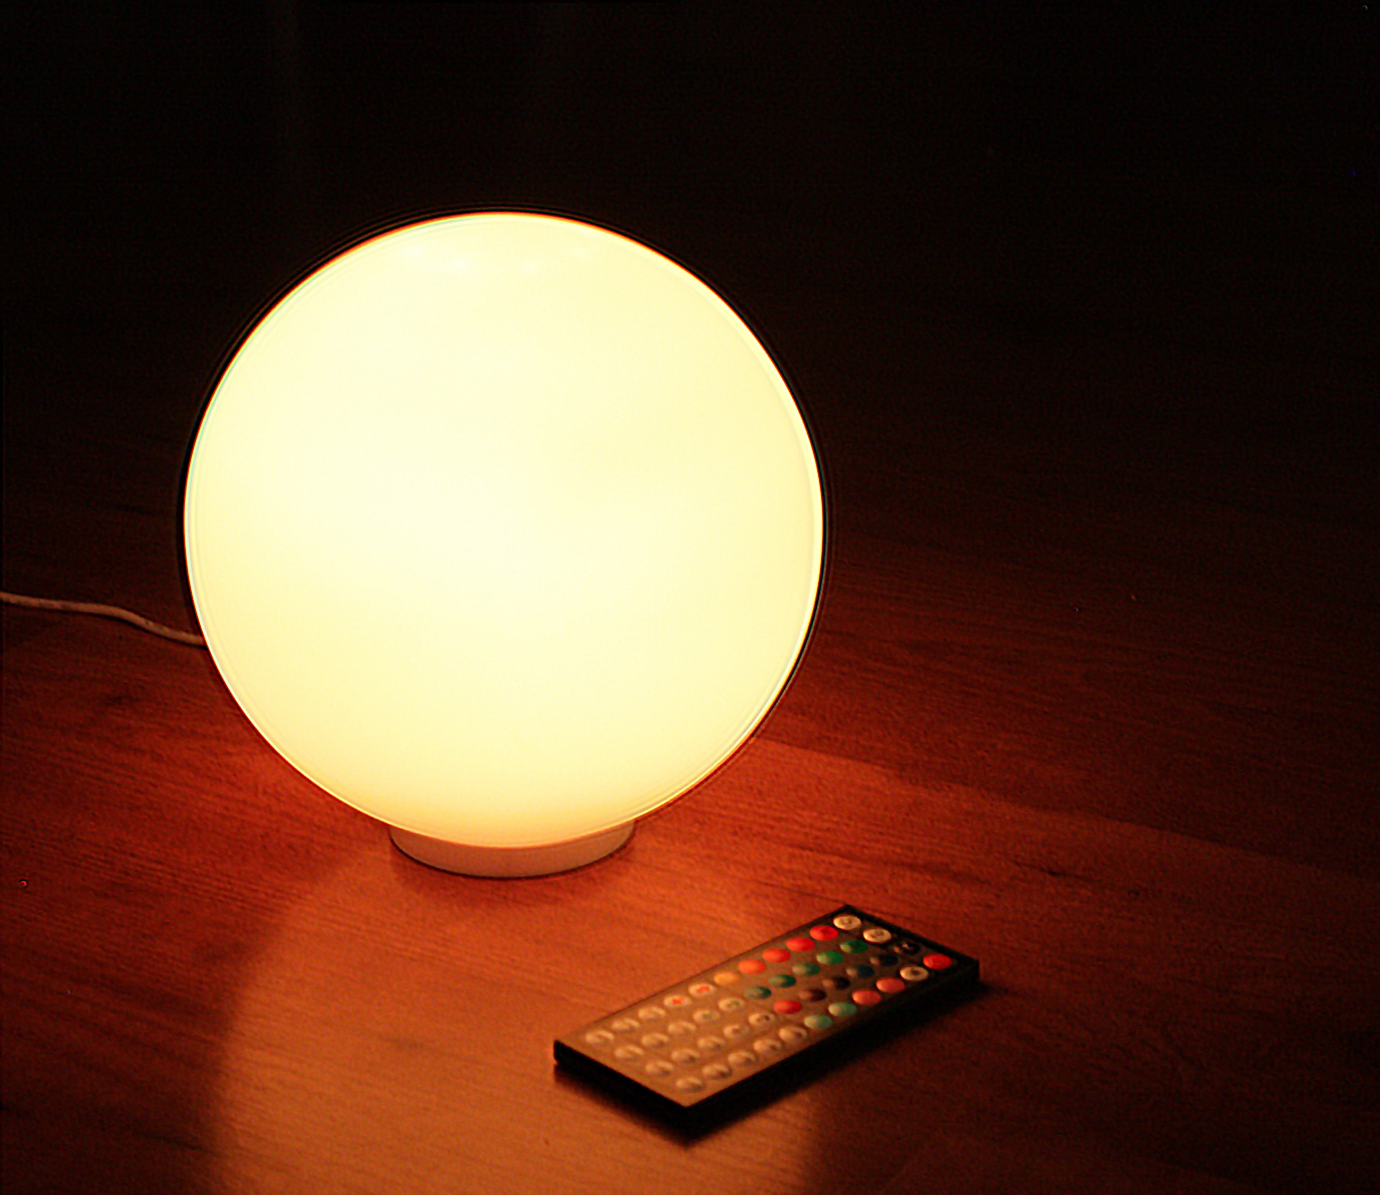
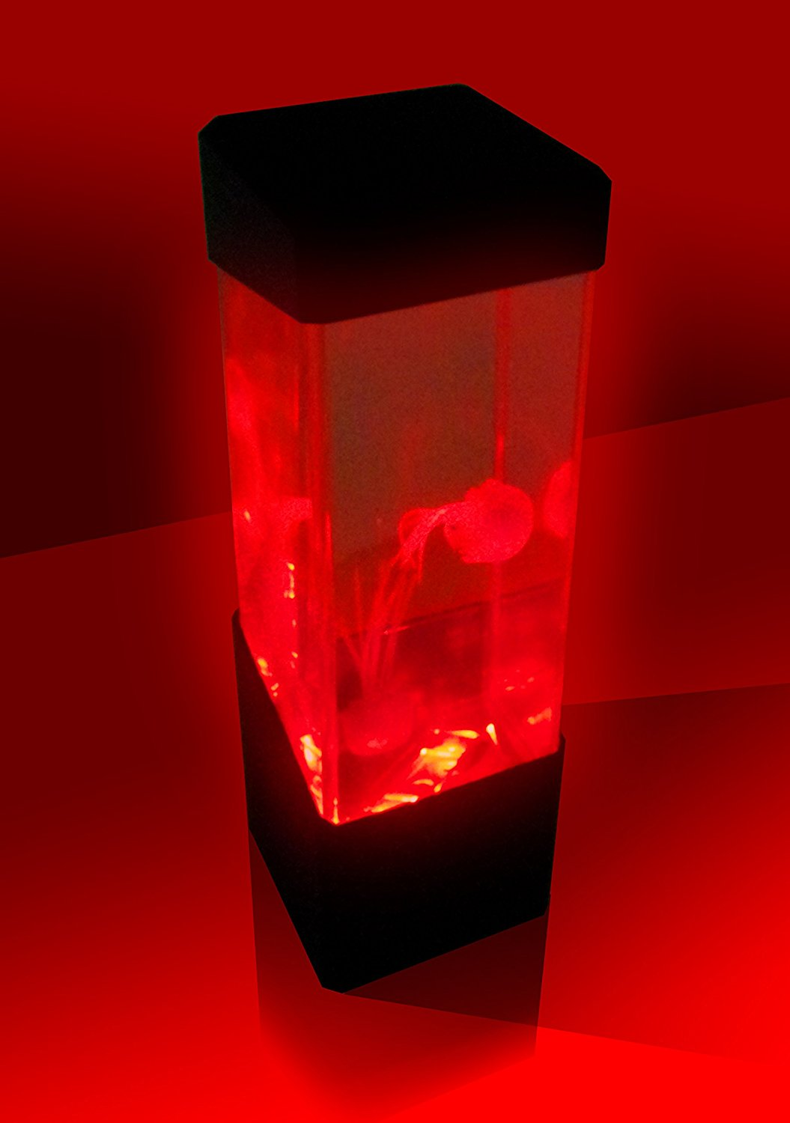
moodlight?
Color adjustable lamp
Name from lights influence on humans mood
Notes:
jonas

Slide 3

Our moodlight
Notes:
felix

Slide 4
Why is our product special?
Alarm function
Aluminium body
Open source software
Notes:
felix

Slide 5

Alarm function
Kitchen timer
Starts alarm sound after a set time
Notes:
felix

Slide 6


Aluminium body
Good passive heat sink
Fireproof
Robust
Light weighted
Simple design
Panel mounted power plug and switch
Notes:
jonas

Slide 7

open source software
Project is on GitHub https://github.com/spectre3141/ETP2
Can be edited/extended
Notes:
jonas

Slide 8

moodlight app
Android app
Remote controlls color settings and alarm settings
Can controll the moodlight from anyware in the room
Notes:
felix

Slide 9
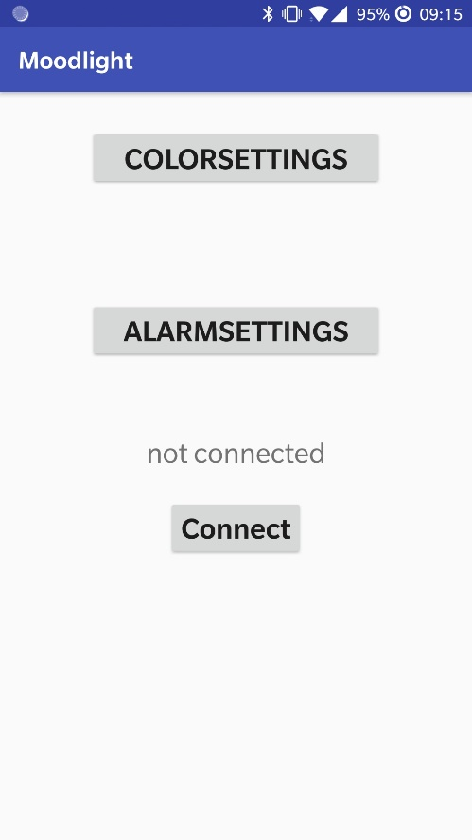
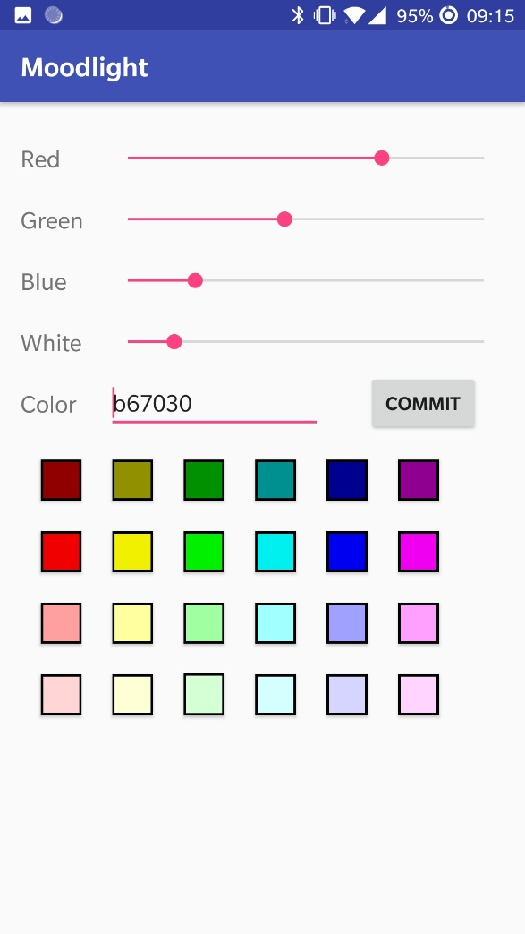
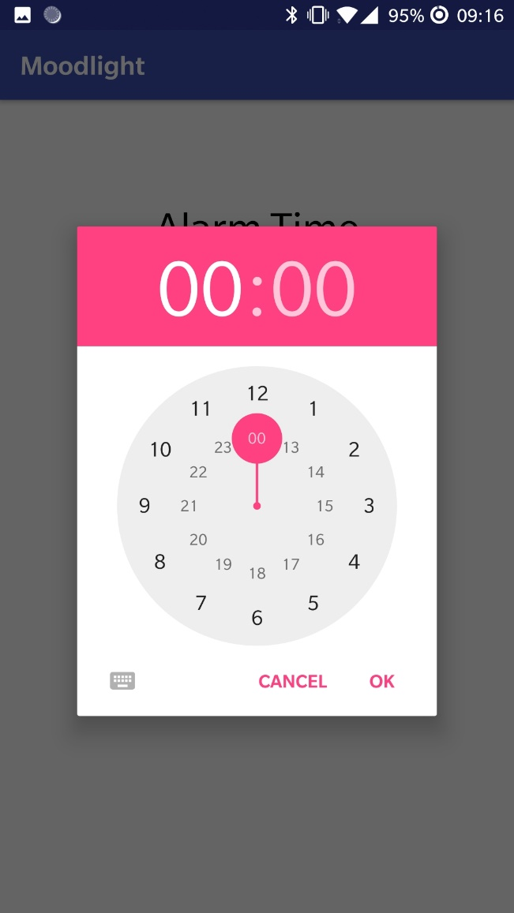
Notes:
felix

Slide 10
Possible enhancements
Expansion of the alarm feature
Light shows
Rough adjustment of alarm sound
Notes:
felix

Slide 11
Set up and usage
Notes:
jonas

Slide 12
Why should you buy our moodlight
Compact and modest design
Fireproof and no fire danger
Easy to use
Possibility of customization
Notes:
Felix/jonas

Slide 13
Notes:
Questions undso

